Slide 1
R&D Flutter
Part 1- Basic concept
by: Nguyen ba tan

Slide 2
Agenda
Overview flutter.
Setup environment
First application
Q&A

Slide 3
Overview
Flutter is an open-source Mobile Application development framework created by Google
Use Dart language
https://github.com/flutter/flutter
Why Dart?
Dart is AOT (Ahead Of Time) compiled to fast https://en.wikipedia.org/wiki/Ahead-of-time_compilation
Dart can be also JIT (Just In Time) compiled https://en.wikipedia.org/wiki/Just-in-time_compilation
Dart makes it easier to create smooth animations and transitions that run at 60fps
Dart allows Flutter to avoid the need for a separate declarative layout language like XML or separate visual interface builders
https://www.dartlang.org/guides/language

Slide 4
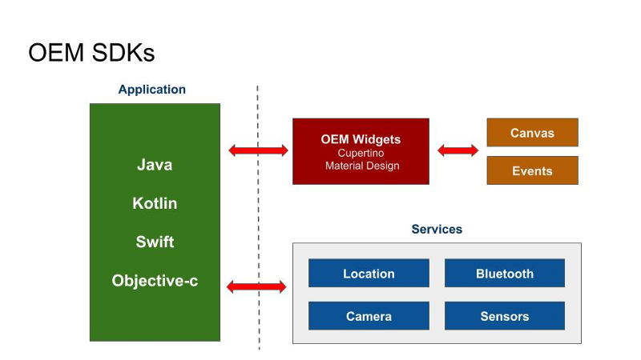
Overview - SDK
Native

Slide 5
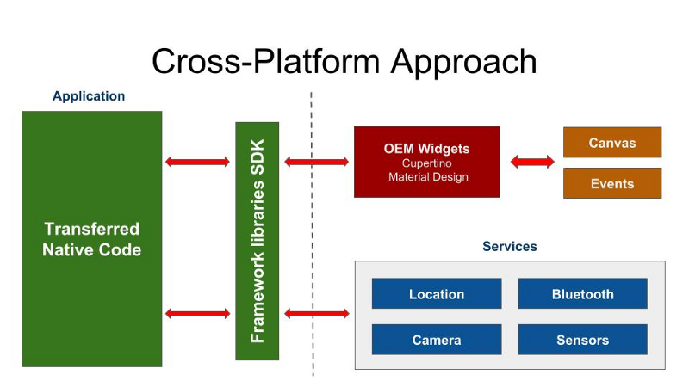
Overview - SDK
Cross-Platform

Slide 6
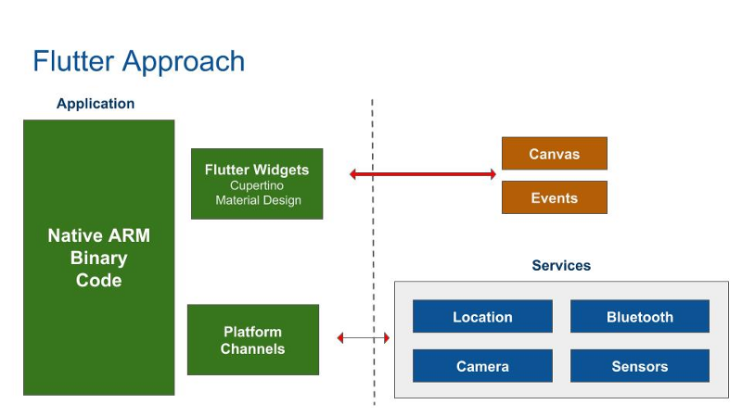
Overview - SDK
Flutter

Slide 7
Overview - SDK
Platforms Channel?
You can have the platform handle somethings and Flutter handle others
Ex: Push Notification
https://documentation.onesignal.com/v5.0/docs/flutter-sdk-setup
Or https://medium.com/flutterpub/enabling-firebase-cloud-messaging-push-notifications-with-flutter-39b08f2ed723

Slide 8
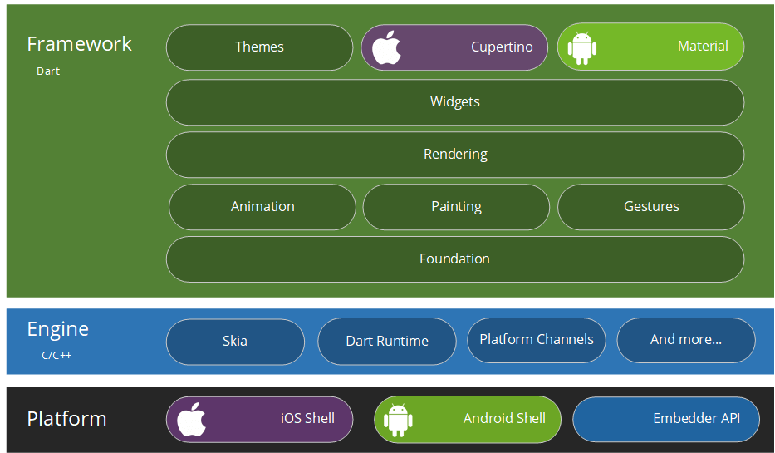
Overview - system

Slide 9
Overview - system
Flutter doesn’t have native controls or component. Flutter only has Widgets.
Flutter draws UI output on a Skia Canvas
https://en.wikipedia.org/wiki/Skia_Graphics_Engine
Flutter works more like a game engine and uses GPU for most of the work.

Slide 10
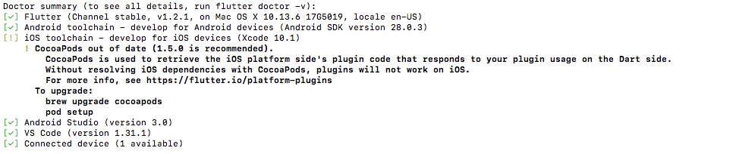
Setup environment
IDE: Android Studio or Visual Code.
Flutter SDK
https://flutter.dev/docs/get-started/install
Download and unzip SDK and add flutter tool to PATH
export PATH="$PATH:`pwd`/flutter/bin"
Terminal -> flutter doctor

Slide 11
Setup environment
Plugin

Slide 12
First application
Open Android Studio
File -> New Flutter Project
Follow step to create new project

Slide 13
First application
Folder structure

Slide 14
First application
Pubspec
Config
Libs
Assests
Fonts

Slide 15
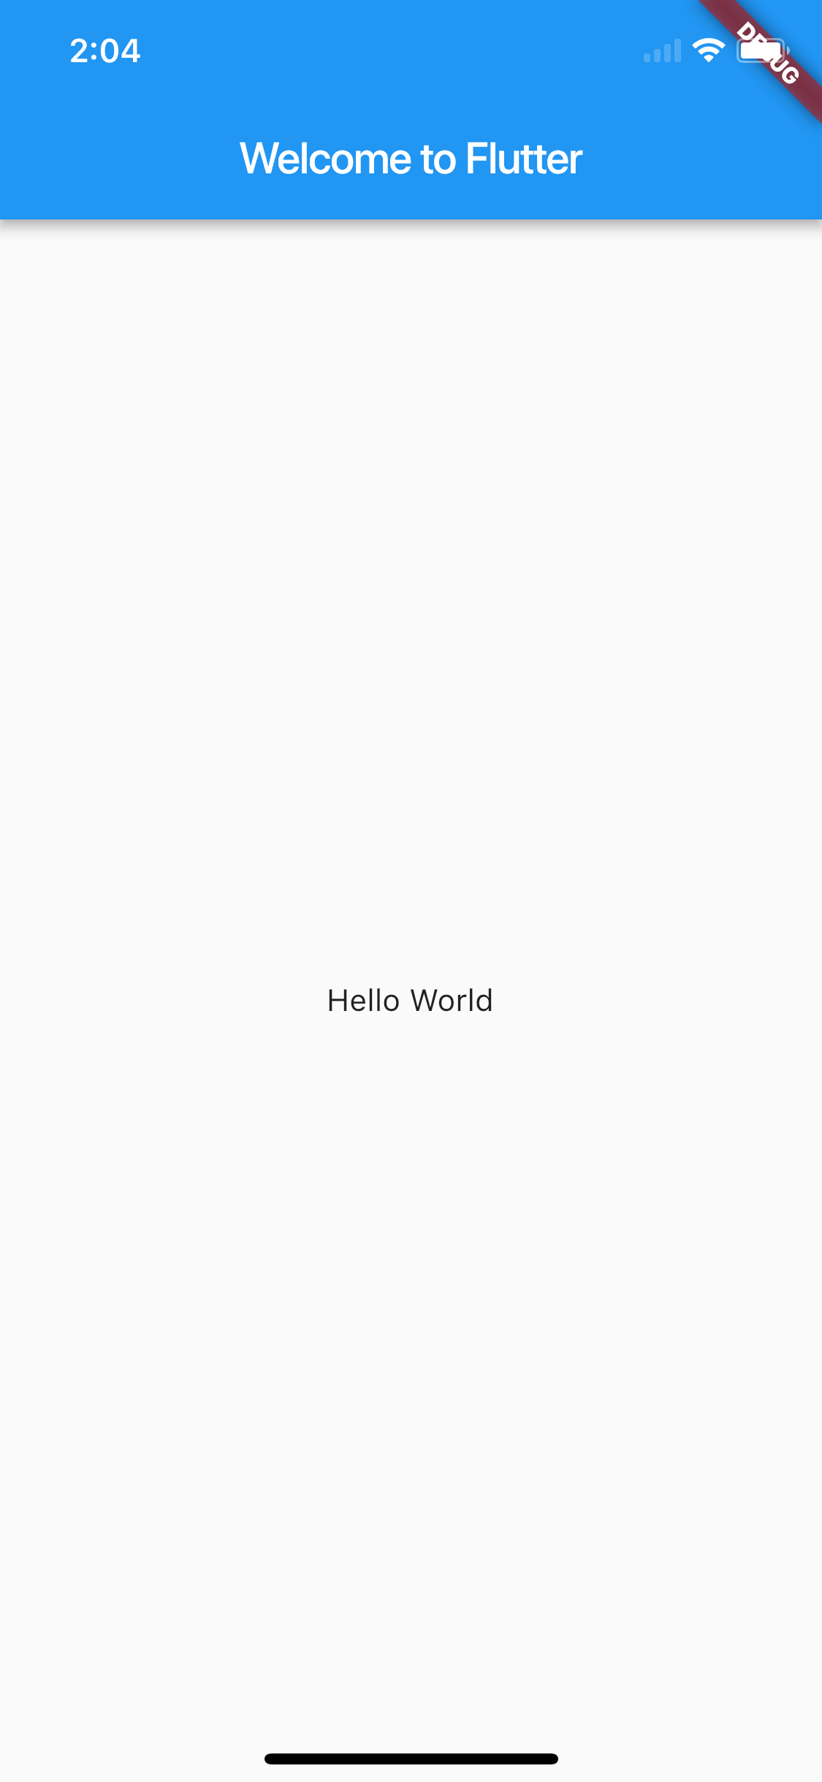
First application
Main.dart

Slide 16
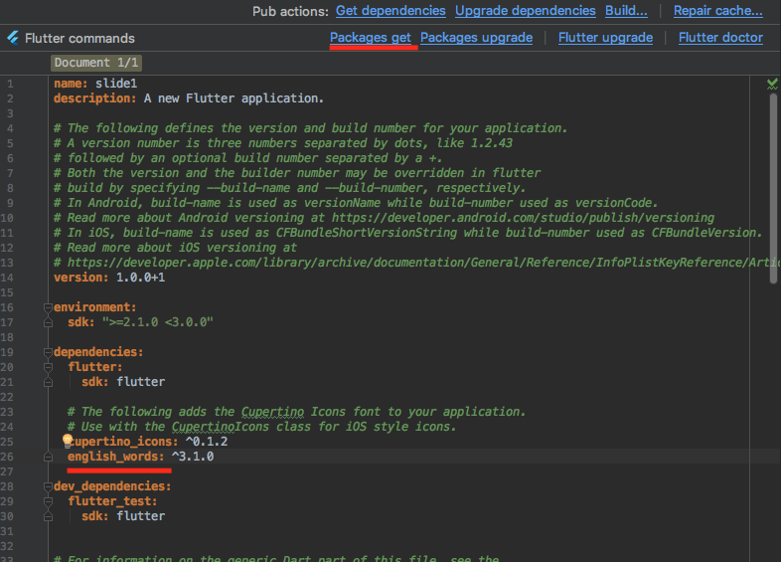
First application
Dependency https://pub.dartlang.org/

Slide 17
First application
Stateful vs Stateless Widget
Stateless widgets are immutable, meaning that their properties can’t change.
Stateful widgets maintain state that might change during lifetime of the widget

Slide 18
First application
Demo Listview

Slide 19
Q&A

